Slide 1

AI Job Growth and Market Analysis
MSDS670 – Data Visualization Final Project
Sriram Devaraju
Jason Koenig
Regis University
March 2026

Slide 2
Problem
Artificial intelligence jobs are increasing in many industries
Employers require different experience levels and technical skills
Salary varies depending on experience and role level
Data visualization helps understand hiring trends over time
Notes:
Artificial intelligence jobs are increasing rapidly across various industries. Nevertheless, it is not always easy to comprehend how the need for a given job changes with time, how the pay varies with experience level, or what skills are most crucial. Using data visualization helps us visualize the trends for various jobs, pay levels, and skills.

Slide 3
Research Question
How did AI job demand change over time, and how do experience level and required technical skills explain salary and hiring patterns in AI job postings?
Notes:
This project aims to analyze the dynamics of job postings related to Artificial Intelligence (AI). My analysis will include trends focused on both demand and experience as measured by salary and most common technical skills reported in job postings. Hiring trends will also be made easier to analyze through the use of data visualization techniques.

Slide 4
Data
Dataset contains thousands of AI job postings
Includes posting date, salary, experience level, and skills
Posting date used for monthly job count chart
Skills column used to find most requested technologies
Notes:
AI job postings dataset contain several different pieces of information about each posting including Posting Date, Salary, Experience Level, and Required Skills. Posting Date is used to format the data into a time series chart. Salary is used to compare the experience levels of different jobs and the skills column is used to tally how many times a particular technology is requested.

Slide 5
Methodology
Python used with pandas and matplotlib
Job postings grouped by month for time-series plot
Salary averaged for each experience level
Skills separated and counted for frequency chart
Notes:
An analysis was done using Python with the following libraries: pandas for cleaning and grouping the data, and matplotlib for producing charts. The monthly trends in job postings were aggregated into counties based on job title and then plotted on a line chart. Also, average salaries were calculated based on the first-opened-to-first closed experience level for a bar chart. Finally, the skills column was separated into individual items so the top skills across companies can be represented.

Slide 6
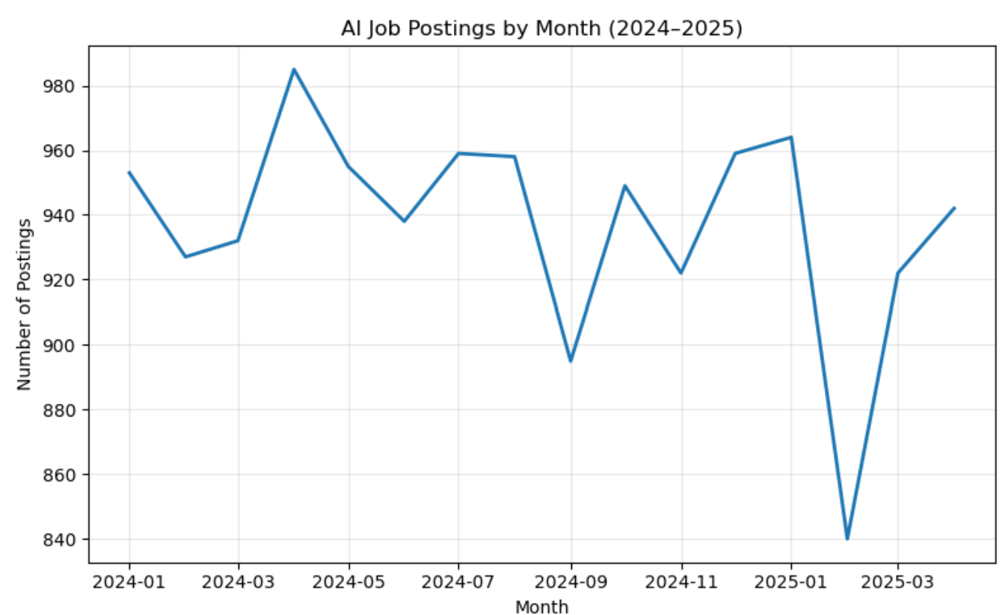
Chart 1 -AI Job Postings by Month (2024–2025)
Job postings stayed consistently high across the period.
Highest postings occurred around April 2024.
Lowest value appears in early 2025.
Overall trend shows steady demand for AI jobs.
Notes:
The following line chart shows the number of AI job postings per month from the first quarter of 2024 through the first quarter of 2025. As we can see, throughout that entire time period, the bulk of postings remain very similar, so the number of job postings for AI jobs has remained steady throughout the timeframe and will most likely continue to be an active area for growth of demand -- the highest posting counts appears in April of 2024 and the lowest posting count appears in the first quarter of 2025; therefore, the trend for the duration of this time frame appears to have either stabilised at (or just above) an average amount versus there being any type of temporary upward or downward trend.

Slide 7
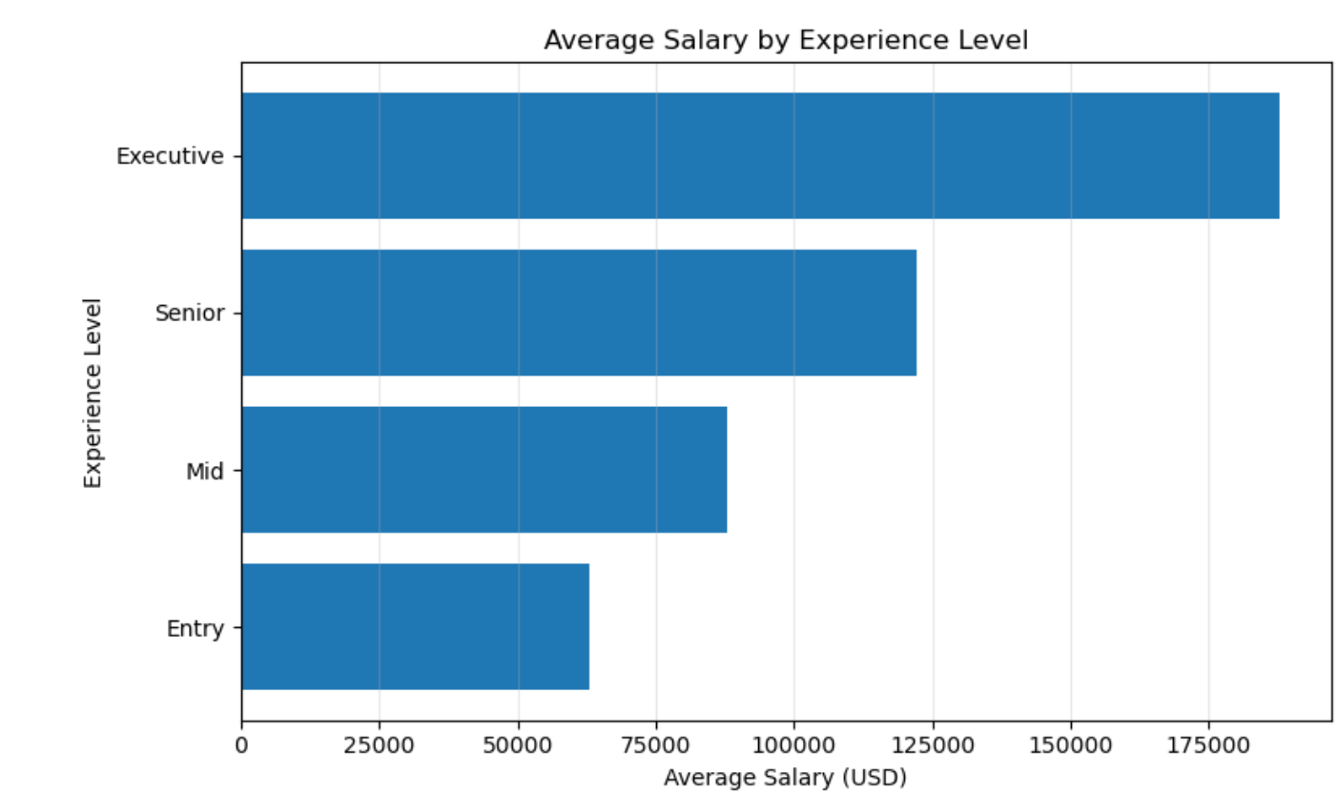
Chart 2 - Average Salary by Experience Level
Salary increases as experience level increases..
Entry level has the lowest average salary.
Executive level has the highest salary.
Experience is a major factor in AI pay.
Notes:
There is a considerable variation in average annual income dependent on an employee’s experience level as can be seen from the graph provided above. Entry-level employees earn less that those who fall into the mid-level category and, of course, far less than those who are executive-level employees. You can see that there is a definite upward trend in average annual income as you move from entry-level to mid-level, senior-level and finally executive-level employees (i.e., AI professionals earn more money as their respective level of experience increases).

Slide 8
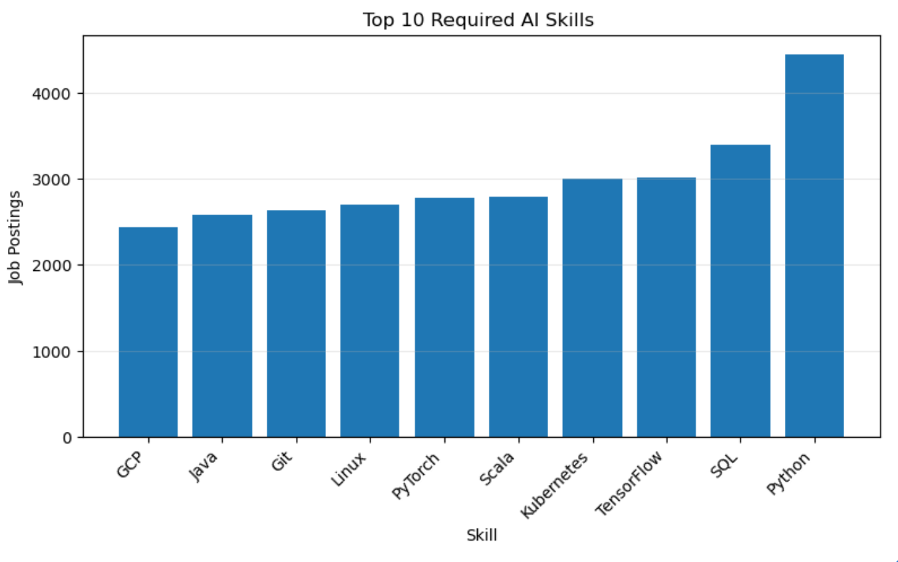
Chart3-Top 10 Required AI Skills
Python is the most requested skill.
SQL and TensorFlow also appear frequently.
Many skills are related to programming and machine learning.
Employers look for both software and AI knowledge
Notes:
According to this data, Python is the most sought-after skill in AI job postings followed directly by SQL and TensorFlow (see graph below). The majority of skills required for these positions relate directly to programming languages used in machine learning and cloud technology. This clearly indicates that companies seek both technical coding skills and working knowledge of artificial intelligence when looking to fill positions in the field of artificial intelligence (AI).

Slide 9
Results
Job postings stayed high, with peak around April 2024
Executive salaries highest, entry salaries lowest
Python, SQL, and TensorFlow most requested skills
Visualizations show clear hiring and salary patterns
Notes:
The first graph indicates that during all of this time AI job listings have had a high number of listings with peak numbers of listings around the month of April 2024 and a decline early in the year 2025. The salary graph shows that the highest paid jobs are those in an executive position, with the rest of the pay for jobs being ordered highest to lowest as: Senior level, Mid Level and Entry Level. The Skills graph indicates that Python is the most common requested skill, with SQL and TensorFlow following as the next two highest requested skills. These three graphs demonstrate the demand and salaries associated with AI Job skills.

Slide 10
Conclusions
AI job demand remained strong over time
Salary increases with experience level
Programming and ML skills are highly valued
Visualization makes job-market trends easy to understand
Notes:
In closing, the analysis indicates that there has been strong demand for AI jobs during the time period. Salary is higher for those with greater experience levels, therefore advanced skills are rewarded. The three skills most commonly needed in AI jobs are: Python, SQL, and TensorFlow, and the above referenced three graphs illustrate how easy it is to see the relationship between each data set.

